Slide 1
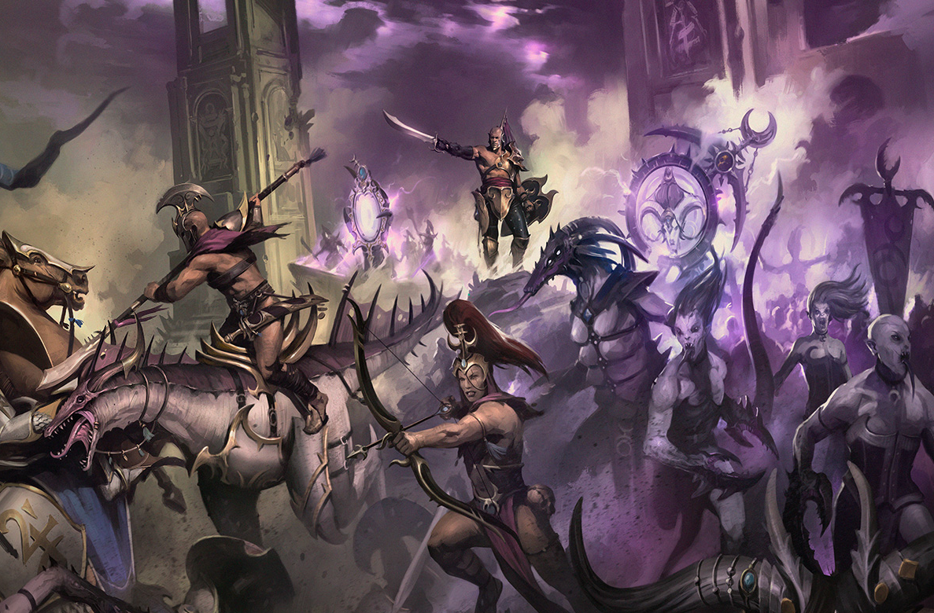
Competitive Warhammer Analysis:
https://github.com/jtspedding

Slide 2
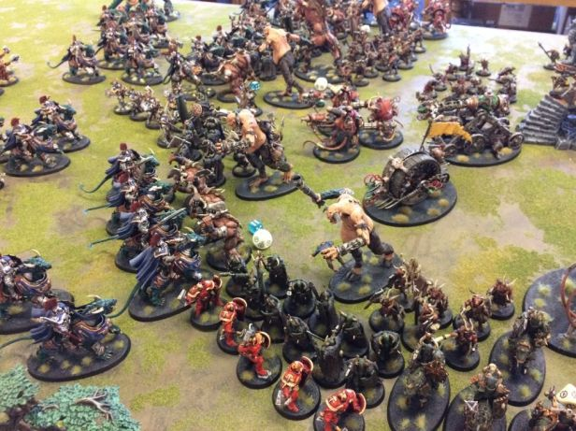
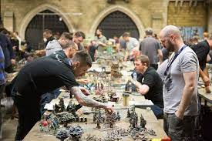
What is Competitive Warhammer:
What is Warhammer AoS:

Slide 3
Analysis Aims:
To optimise my future lists by identifying…
Units that are under-costed based on their statistics,
Units that are over-costed based on their statistics.

Slide 4
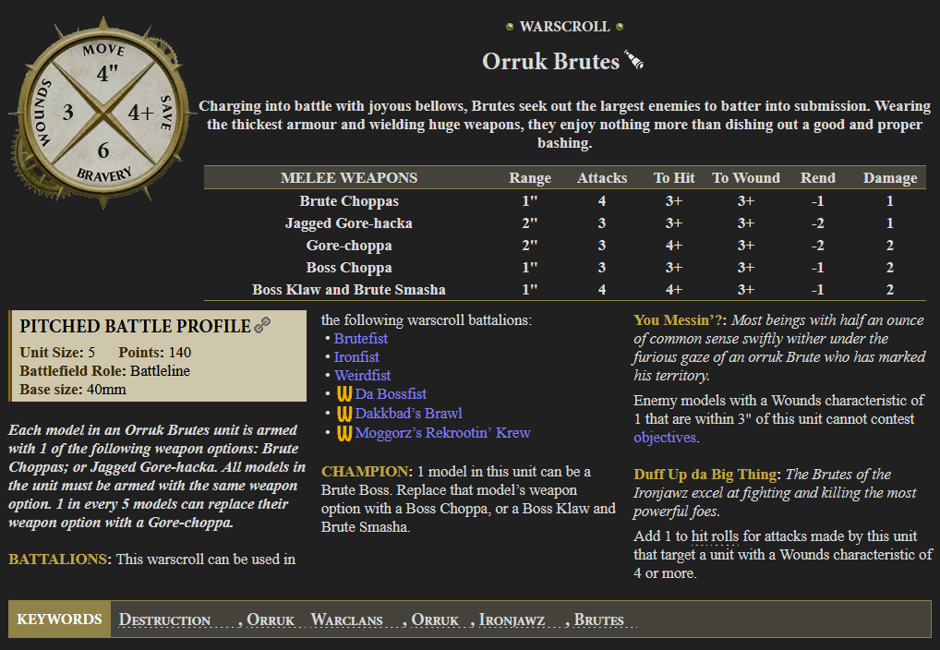
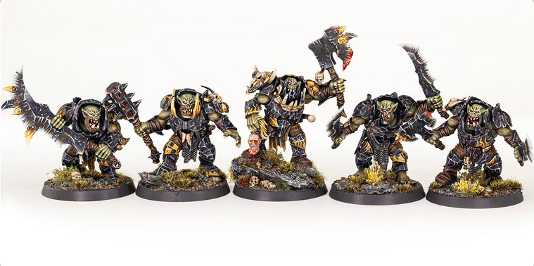
Unit Warscroll:

Slide 5
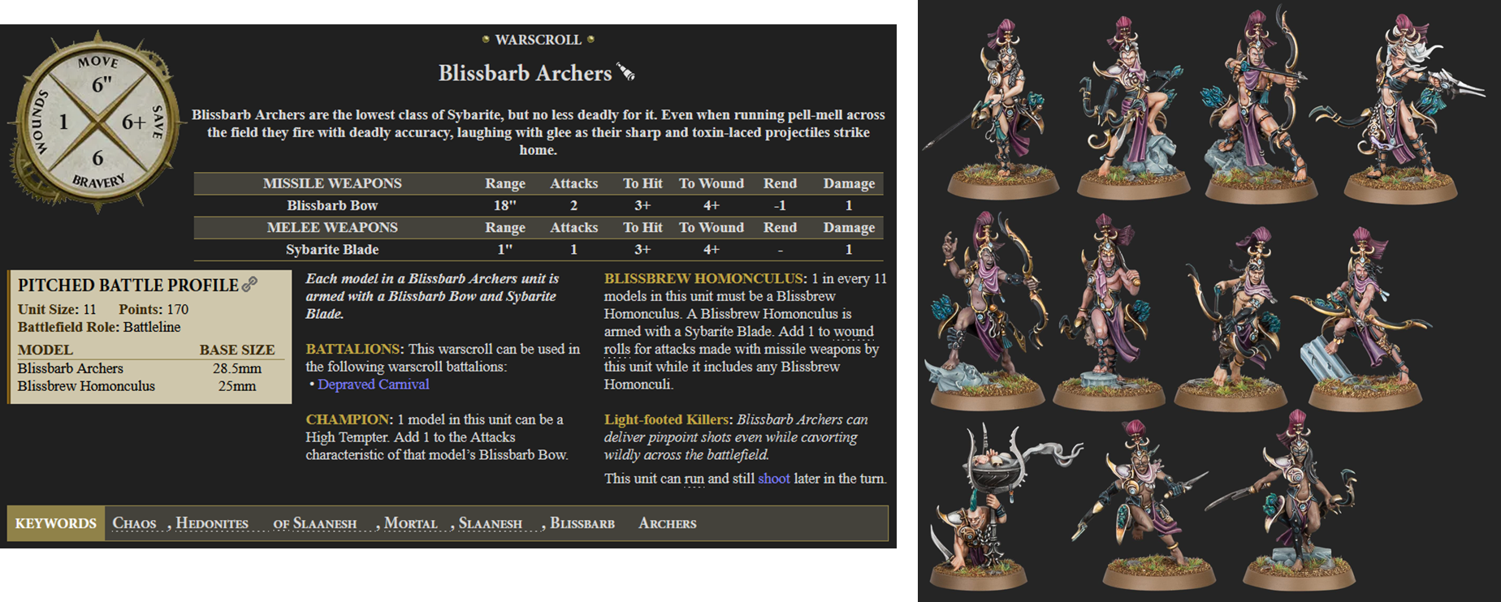
Unit Warscroll:

Slide 6
Unit Warscroll:

Slide 7
Unit Warscroll:

Slide 8
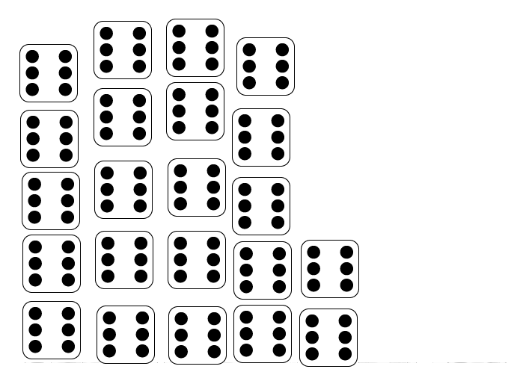
Unit Warscroll:

Slide 9
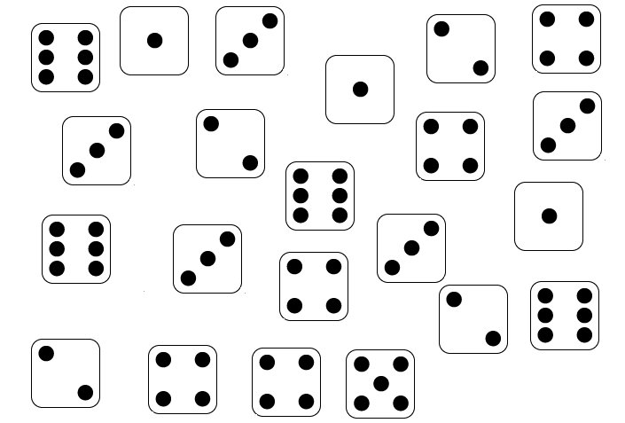

Unit Warscroll:

Slide 10
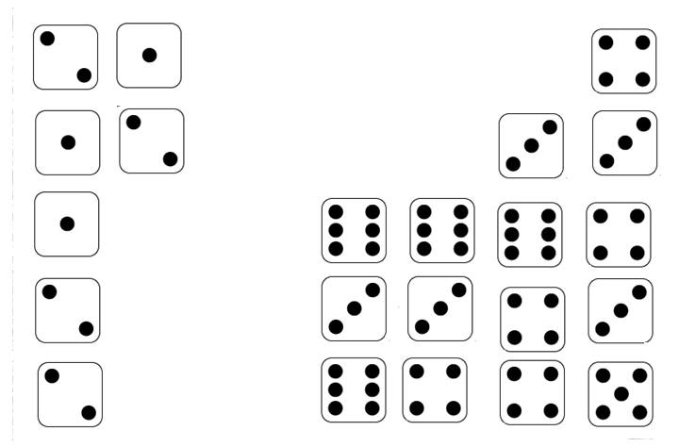
Unit Warscroll:
15 hits, 7 fails

Slide 11
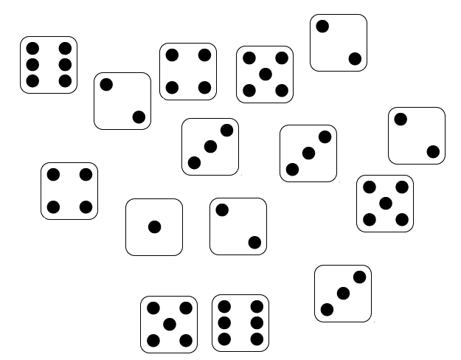
Unit Warscroll:

Slide 12
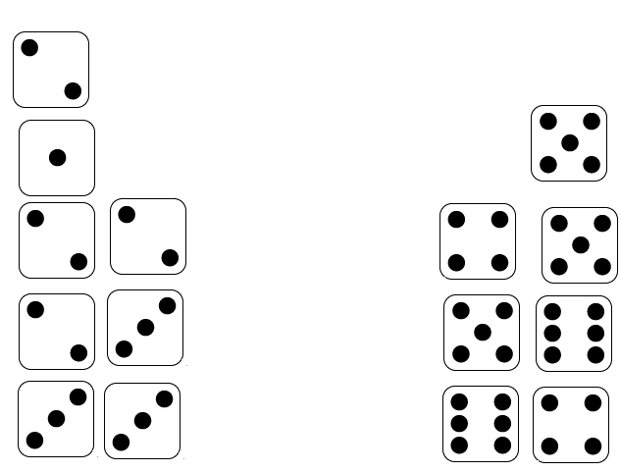
Unit Warscroll:
7 wounds, 8 fails

Slide 13
Unit Warscroll:

Slide 14
Unit Warscroll:

Slide 15
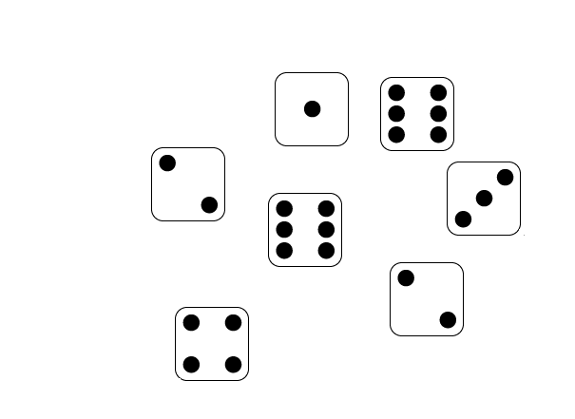
Unit Warscroll:

Slide 16
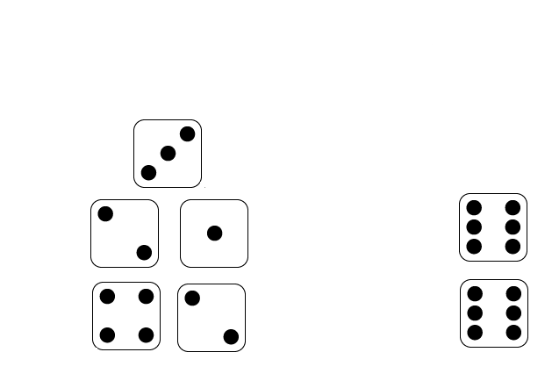
Unit Warscroll:
2 saves, 5 fails

Slide 17
Unit Warscroll:

Slide 18
Unit Warscroll:
One out of three wounds remaining

Slide 19
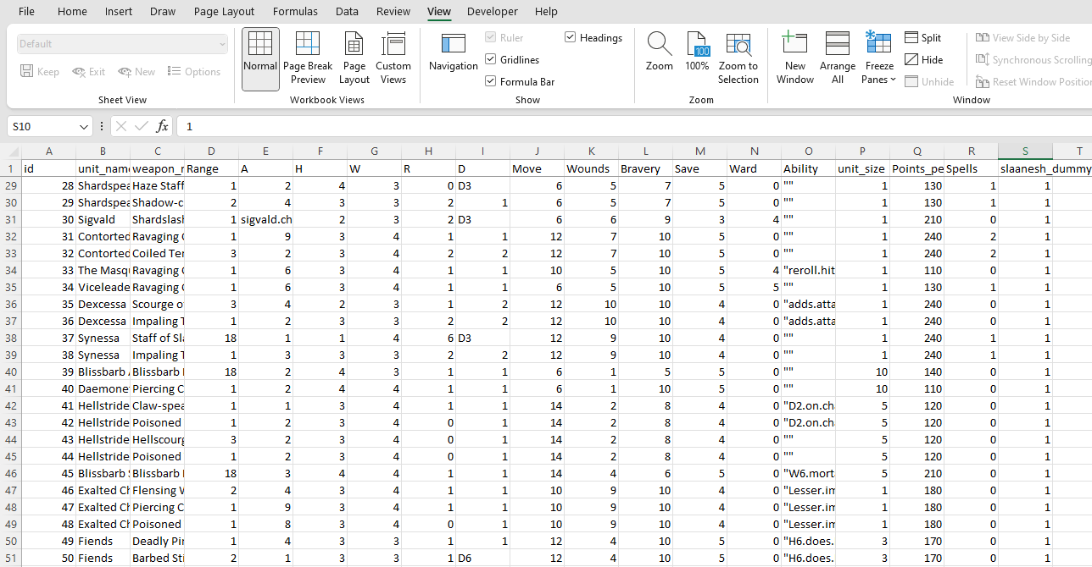
Unit Warscroll:
Units Points Cost
(target variable)

Slide 20
Unit Warscroll:

Slide 21
Warhammer Analysis:
Stats Time!

Slide 22
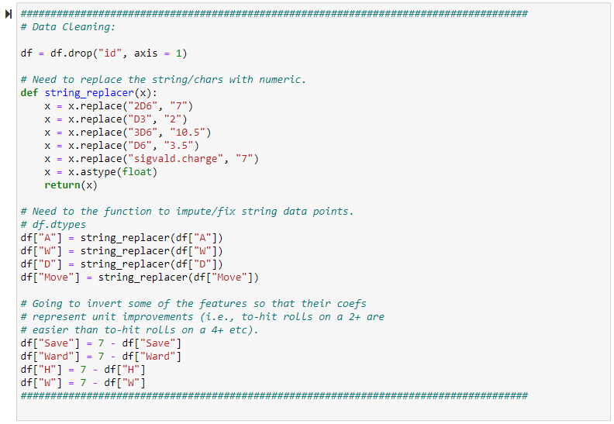
Warhammer Analysis:
Data Collection:
Attempted to pull data from Websites but alas the html was too dense. Therefore so manual processing was required (n = 172).
Data Cleaning:
Impute string values as relevant integers (e.g., D6 == 3.5).
Invert dice roll values (not necessary but helpful to quickly interpret interactions).
Compute unit wounds by unit size features.

Slide 23
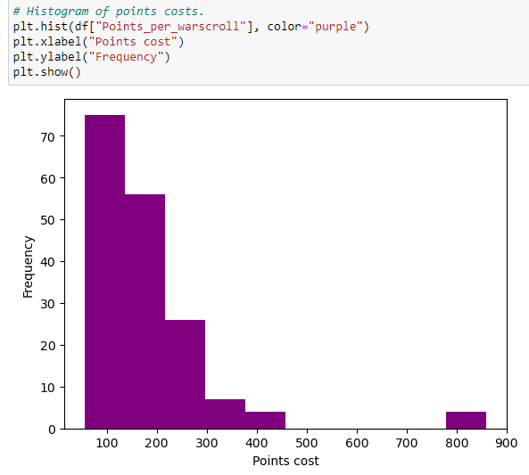
Warhammer Analysis:
EDA:
Examine feature histograms.

Slide 24
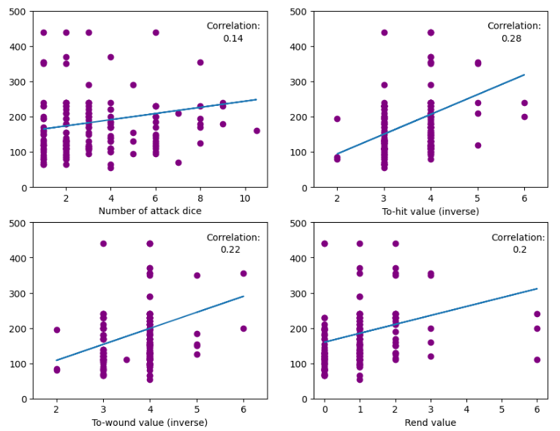
Warhammer Analysis:
EDA:
Examine scatterplots between the target and features.

Slide 25
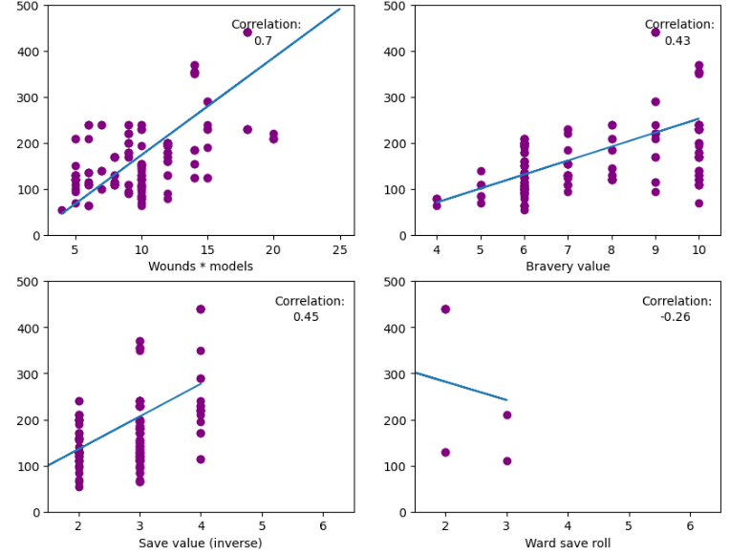
Warhammer Analysis:
EDA:
Examine scatterplots between the target and features.

Slide 26
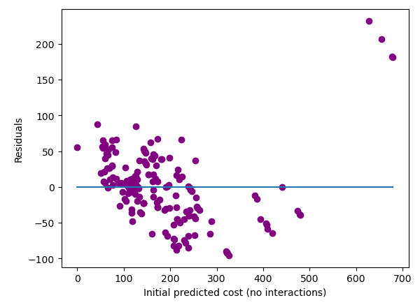
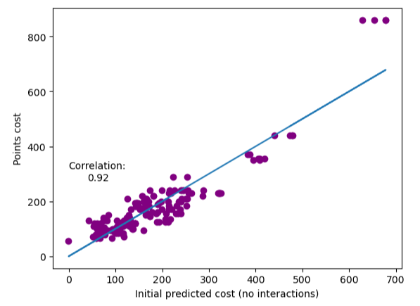
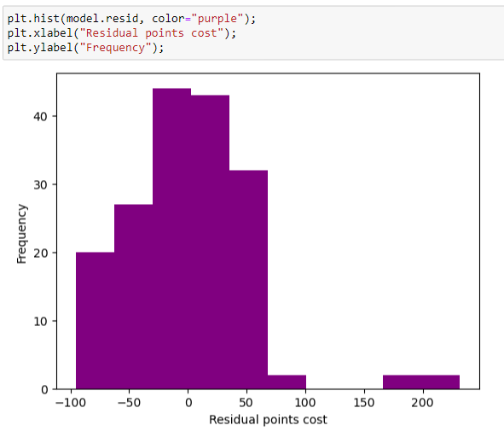
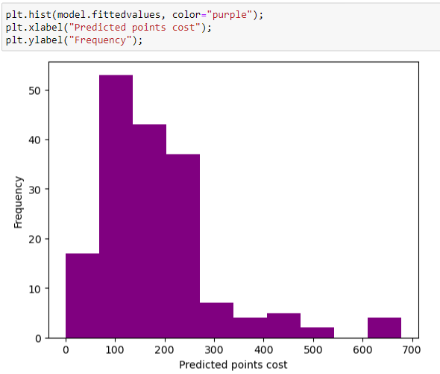
Warhammer Analysis:
EDA:
Examine predicted values.
Examine residual values.
OLS assumptions etc.

Slide 27
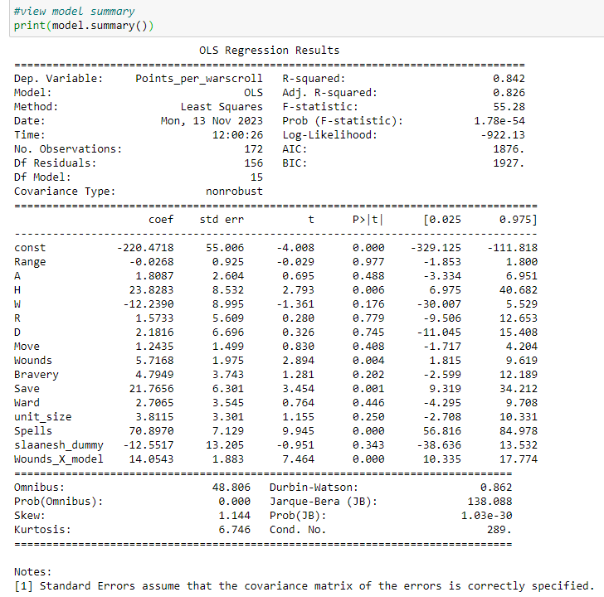
Warhammer Analysis:
EDA:
Examine initial regression model coefficients.

Slide 28
Warhammer Analysis:
EDA:
Examine initial regression model coefficients.
Solved issue with high-low wounds and model counts.

Slide 29
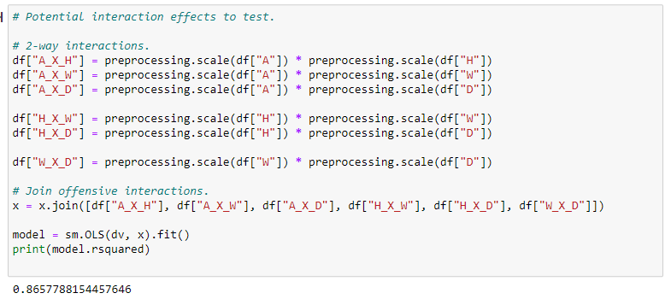
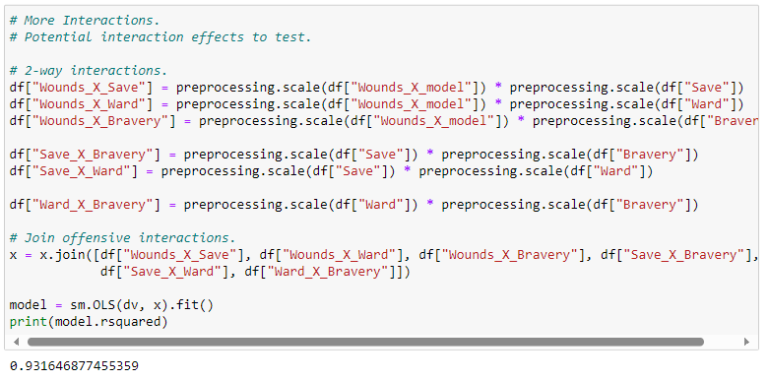
Warhammer Analysis:
Feature Engineering:
Standardise (or centre) variables and compute all 2-way interactions…

Slide 30
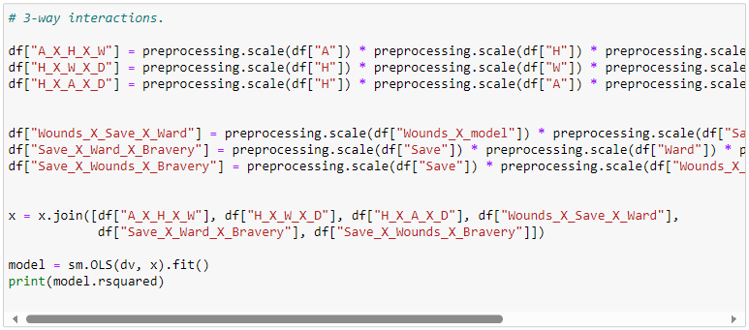
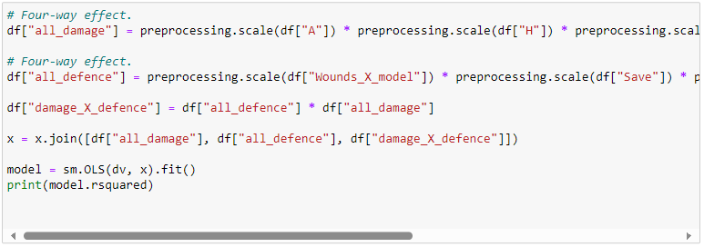
Warhammer Analysis:
Feature Engineering:
…and similarly for all 3-way and 4-way interaction effects

Slide 31
Warhammer Analysis:
Data is ready to roll!!

Slide 32

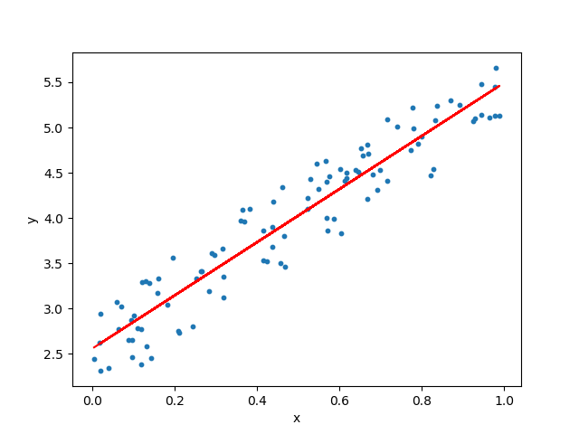
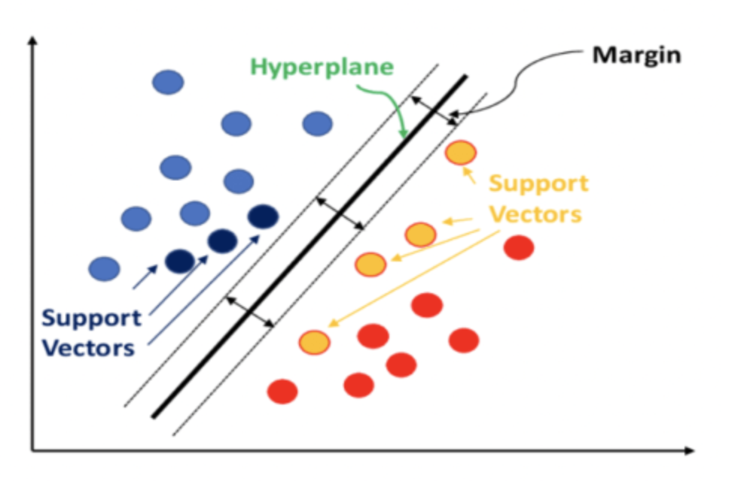
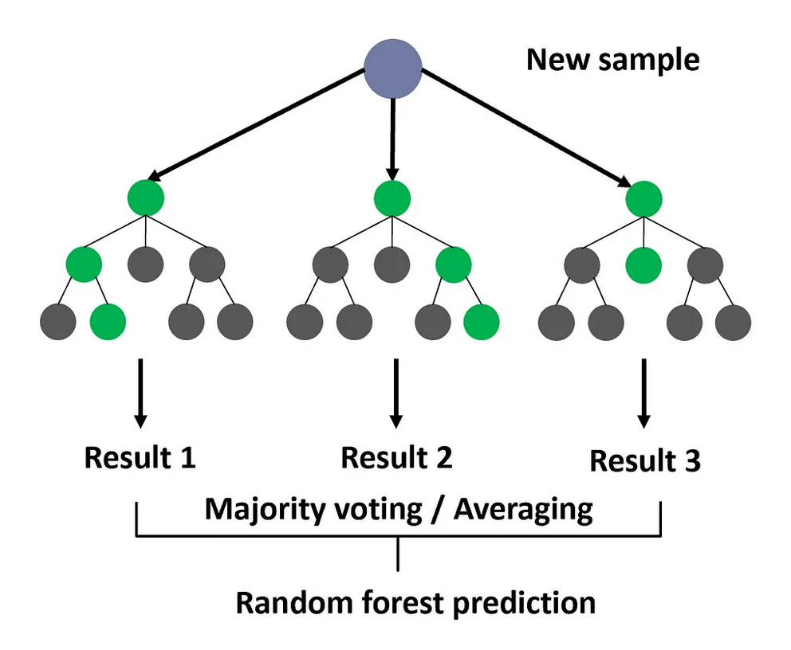
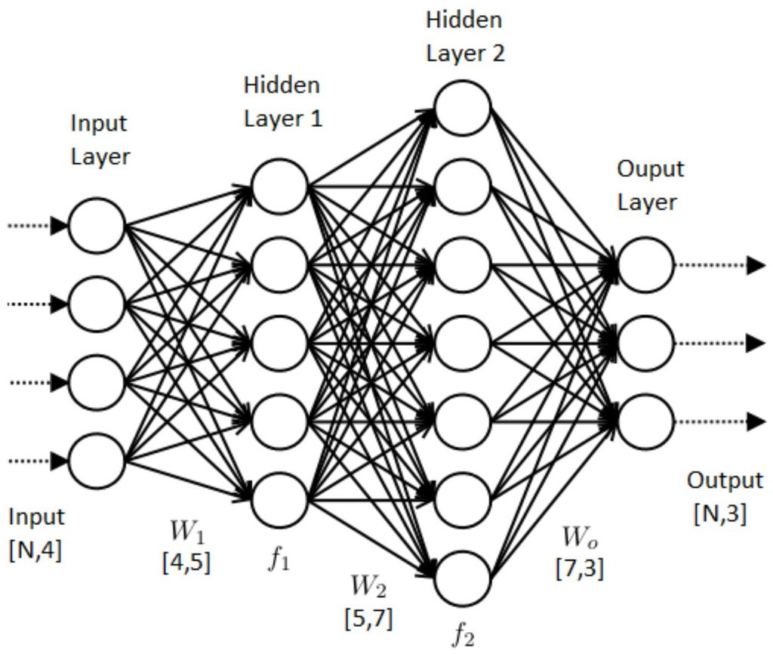
Warhammer Analysis:
Me and the boys about to go find some insights

Slide 33
Warhammer Analysis:
Support Vector Machines:
Common non-linear classifier (but also apparently does regression). Will find optimal (hyper)plane to separate data.
Maximizes margins between classes based on nearby datum.
Will predict new inputs based on there location within margins.

Slide 34
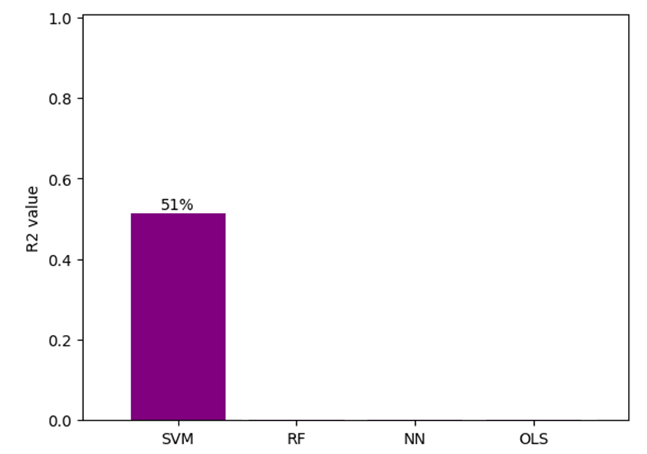
Warhammer Analysis:
Support Vector Machines:
Common non-linear classifier (but also apparently does regression). Will find optimal (hyper)plane to separate data.
Maximizes margins between classes based on nearby datum.
Will predict new inputs based on there location within margins.

Slide 35
Warhammer Analysis:
Random Forest Boi ™:
Uses decision tree methods to classify cases.
Each individual tree is a poor predictor, however when aggregated (bagging/boosted) results are more accurate.
Uses random selection of predictor variables.

Slide 36
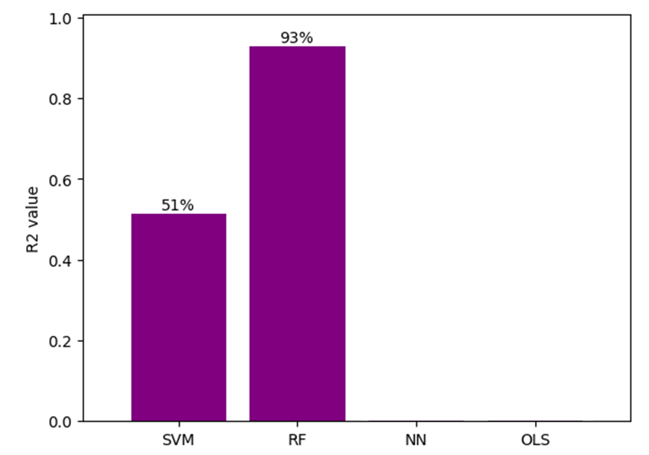
Warhammer Analysis:
Random Forest Boi ™:
Uses decision tree methods to classify cases.
Each individual tree is a poor predictor, however when aggregated (bagging/boosted) results are more accurate.
Uses random selection of predictor variables.

Slide 37
Warhammer Analysis:
Neural Network:
Designed to mimic human synaptic processes.
Networks contain input, hidden, and output layers.
Each node adds weights and biases to the function. These forms an activation function.

Slide 38
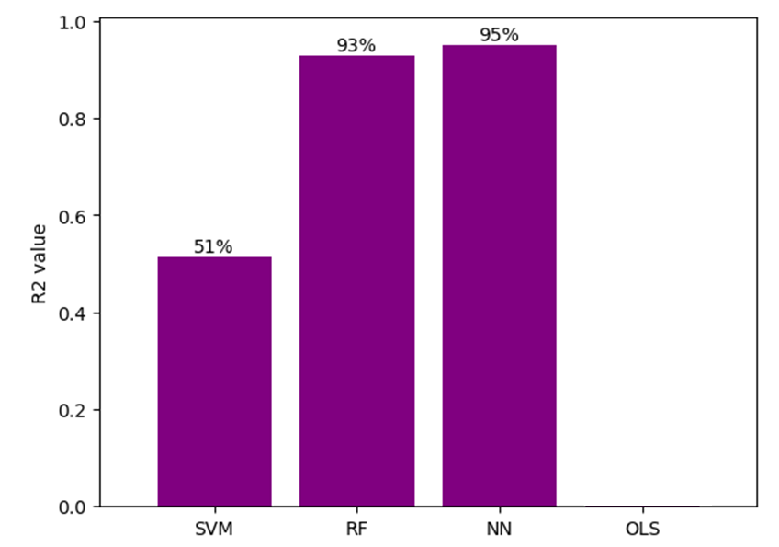
Warhammer Analysis:
Neural Network:
Designed to mimic human synaptic processes.
Networks contain input, hidden, and output layers.
Each node adds weights and biases to the function. These forms an activation function.

Slide 39
Warhammer Analysis:
Linear Regression:
Fits a line to the data using ordinary least squares.
Minimises residuals.
Can be used to model continues target variables.

Slide 40
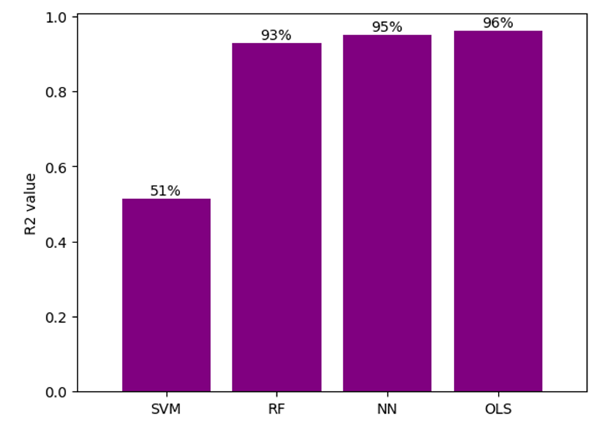
Warhammer Analysis:
Linear Regression:
Fits a line to the data using ordinary least squares.
Minimises residuals.
Can be used to model continues target variables.

Slide 41
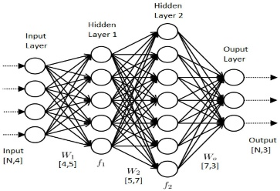


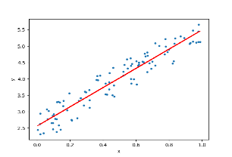
Warhammer Analysis:
Uses massive computing
Is difficult to interpret
Tuning is time-consuming
Is cringe
Algos are still being optimised
Requires massive data
Fails to converge
Can literally be calculated by hand
coefs tell you how to interpret
What are compute costs?
Perfected by Gauss 1795
Requires small samples
Is the best linear unbiased est.

Slide 42
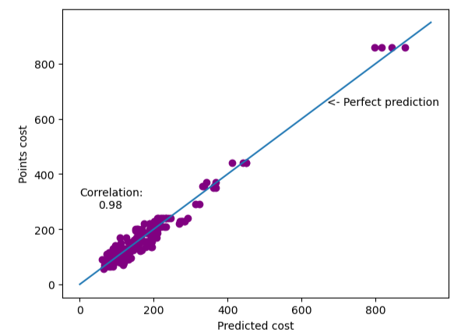
Warhammer Analysis:
Uses massive computing
Is difficult to interpret
Tuning is time-consuming
Is cringe
Algos are still being optimised
Requires massive data
Fails to converge
Can literally be calculated by hand
coefs tell you how to interpret
What are compute costs?
Perfected by Gauss 1795
Requires small samples
Is the best linear unbiased est.

Slide 43
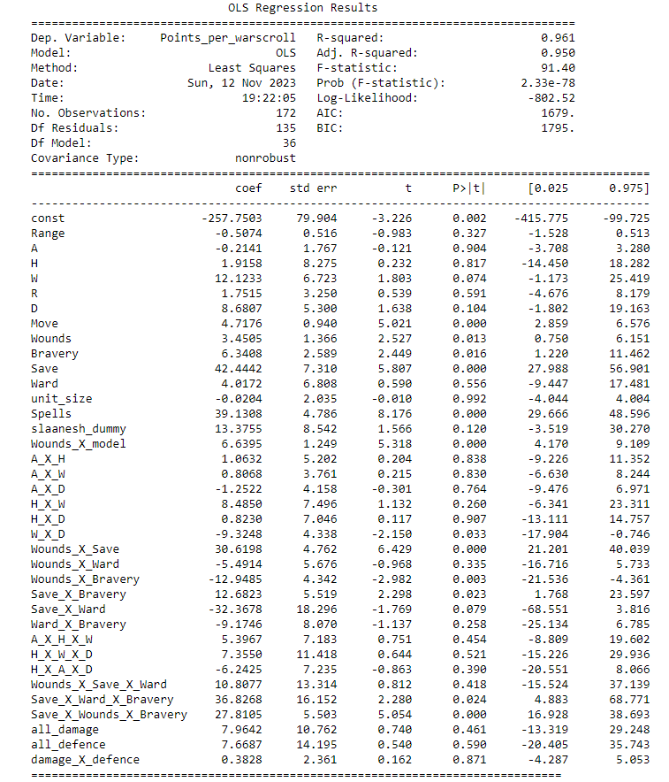
Warhammer Analysis:
Uses massive computing
Is difficult to interpret
Tuning is time-consuming
Is cringe
Algos are still being optimised
Requires massive data
Fails to converge
Can literally be calculated by hand
coefs tell you how to interpret
What are compute costs?
Perfected by Gauss 1795
Requires small samples
Is the best linear unbiased est.

Slide 44
Warhammer Analysis:
Uses massive computing
Is difficult to interpret
Tuning is time-consuming
Is cringe
Algos are still being optimised
Requires massive data
Fails to converge
Can literally be calculated by hand
coefs tell you how to interpret
What are compute costs?
Perfected by Gauss 1795
Requires small samples
Is the best linear unbiased est.

Slide 45
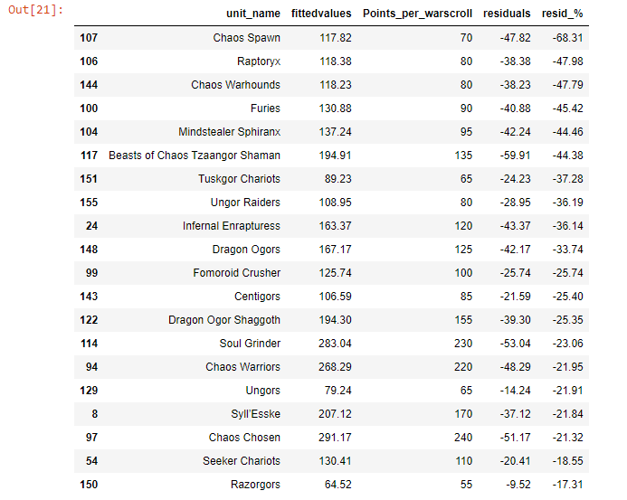
Warhammer Analysis:
Negative Residuals = Under-costed Units
Uses massive computing
Is difficult to interpret
Tuning is time-consuming
Is cringe
Algos are still being optimised
Requires massive data
Fails to converge
Can literally be calculated by hand
coefs tell you how to interpret
What are compute costs?
Perfected by Gauss 1795
Requires small samples
Is the best linear unbiased est.

Slide 46
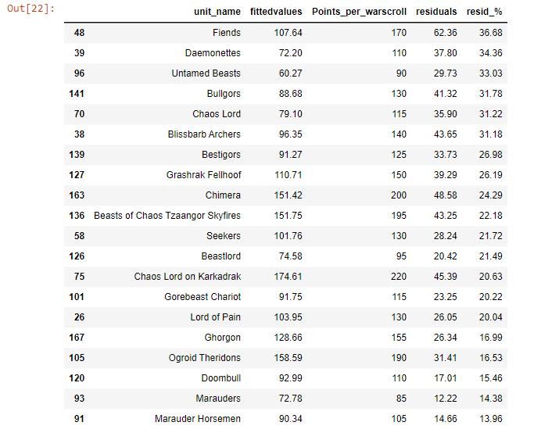
Warhammer Analysis:
Positive Residuals = Over-costed Units
Uses massive computing
Is difficult to interpret
Tuning is time-consuming
Is cringe
Algos are still being optimised
Requires massive data
Fails to converge
Can literally be calculated by hand
coefs tell you how to interpret
What are compute costs?
Perfected by Gauss 1795
Requires small samples
Is the best linear unbiased est.

Slide 47
Warhammer Analysis:
Positive Residuals = Over-costed Units
Uses massive computing
Is difficult to interpret
Tuning is time-consuming
Is cringe
Algos are still being optimised
Requires massive data
Fails to converge
Can literally be calculated by hand
coefs tell you how to interpret
What are compute costs?
Perfected by Gauss 1795
Requires small samples
Is the best linear unbiased est.

Slide 48
Warhammer Analysis:
Question:
Why did the OLS model outperform the more advanced
ML approaches?

Slide 49
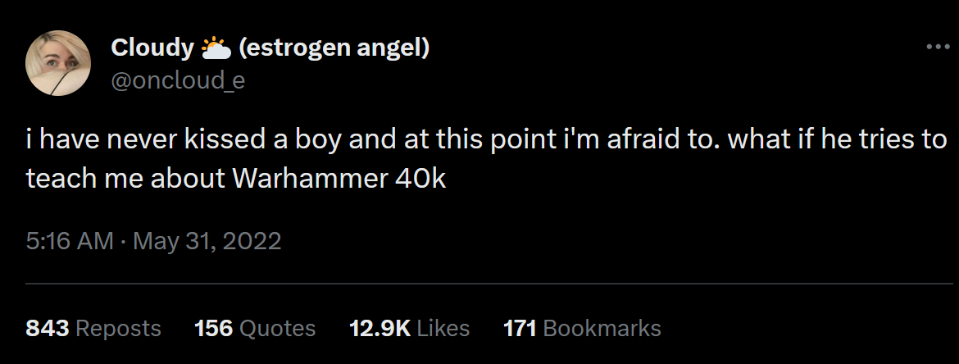
Questions:

